Slide 1
CISC 233 Exam 4 Exercises
Matthew Sabo

Slide 2
Search Instructions
Following the example of Problem Sets 5 and 6, fill out the tables showing the evolution of the fringe when searching the tree with the specified method.

Slide 3
EX 1: Breadth-First
S
SELECT | NEW NODES | FRINGE
 |  | S
S | A, D, H | A, D, H
A | C, B | C, B, D, H
D | G | C, B, G, H
H | I | C, B, G
C | - | B, G
B | E, F | G, I , E, F
G | - | I, E, F
I*
A
D
H
C
B
G
I
E
F
K
J

Slide 4
EX 2: Depth-First
S
SELECT | NEW NODES | FRINGE
 |  | S
E | A, D, H | A, D, H
A | C, B | D, H, C, B
C | - | D, H, B
B | E, F | D, H, E, F
E | - | D, H, F
F | - | D, H
D | G | G, H
G | - | H
H*
A
D
H
C
B
G
I
E
F
K
J

Slide 5
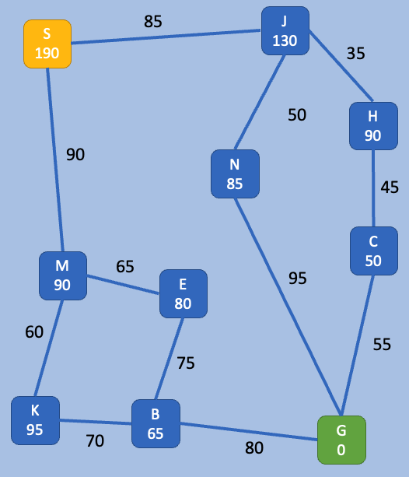
Uniform Cost
Following the example from homework, fill in the chart below for UNIFORM COST search
S is starting point
G is goal
values on arcs represent actual cost for that path
values in nodes represent estimated cost to goal
include ‘path so far’ (e.g., node E can be reached via SM or via SMKB)
SELECT | NEW NODES | FRINGE
 |  | S(–, 0)
S | J(S, 85), M(S, 90) | J(S, 85), M(S, 90)
J | H(SJ, 120), N(SJ, 135) | M(S, 90), H(SJ, 120), N(SJ, 135)
M | K(SM, 150), E(SM, 155) | H(SJ, 120), N(SJ, 135), K(SM, 150), E(SM, 155)
H | C(SJH, 165) | N(SJ, 135), K(SM, 150), E(SM, 155), C(SJH, 165)
N | G(SJN, 230) | K(SM, 150), E(SM, 155), C(SJH, 165), G(SJN, 230)
K | B(SMK, 220) | E(SM, 155), C(SJH, 165), B(SMK, 220), G(SJN, 230)
E | B(SME, 230) | C(SJH, 165), B(SMK, 220), B(SME, 230), G(SJN, 230)
C | G(SJHC, 220) | B(SMK, 220), G(SJHC, 220), B(SME, 230), G(SJN, 230)
B | G(SMKB, 300) | G(SJHC, 220), B(SME, 230), G(SJN, 230), G(SMKB, 300)
G*

Slide 6
Greedy
Following the example from homework, fill in the chart below for GREEDY BEST-FIRST search
S is starting point
G is goal
values on arcs represent actual cost for that path
values in nodes represent estimated cost to goal
include ‘path so far’ (e.g., node E can be reached via SM or via SMKB)
SELECT | NEW NODES | FRINGE
 |  | S(–, 190)
S | M(S, 90), J(S, 130) | M(S, 90), J(S, 130)
M | E(SM, 80), K(SM, 95) | E(SM, 80), K(SM, 95), J(S, 130)
E | B(SME, 65) | B(SME, 65), K(SM, 95), J(S, 130)
B | G(SMEB, 0) | G(SMEB, 0), K(SM, 95), J(S, 130)
G*

Slide 7
A*
Following the example from homework, fill in the chart below for A* search
S is starting point
G is goal
values on arcs represent actual cost for that path
values in nodes represent estimated cost to goal
include ‘path so far’ (e.g., node E can be reached via SM or via SMKB)
SELECT | NEW NODES | FRINGE
 |  | S(–, 0+190)
S | M(S, 90+90), J(S, 85+130) | M(S, 180), J(S, 215)
M | E(SM, 155+80), K(SM, 150+95) | J(S, 215), E(SM, 235), K(SM, 245)
J | H(SJ, 120+90), N(SJ, 135+85) | H(SJ, 210), N(SJ, 220), E(SM, 235), K(SM, 245)
H | C(SJH, 165+50) | C(SJH, 215), N(SJ, 220), E(SM, 235), K(SM, 245)
C | G(SJHC, 220+0) | N(SJ, 220), G(SJHC, 220), E(SM, 235), K(SM, 245)
N | G(SJN, 230+0) | G(SJHC, 220), G(SJN, 230), E(SM, 235), K(SM, 245)
G*

